Slide 1
Can We Spot The Right Spot
Ridley Arp
Machine Learning – Metis
April 20th, 2022

Slide 2

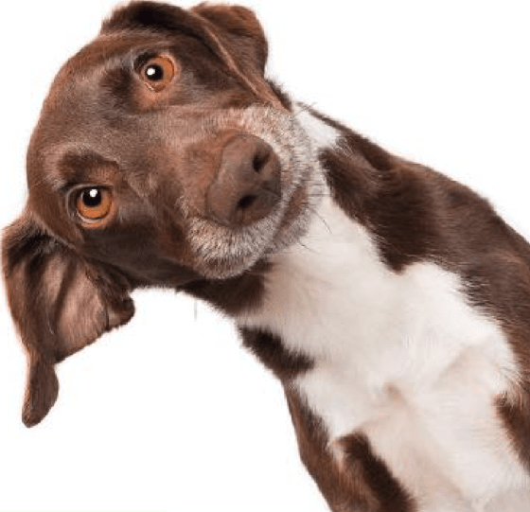
Better Together
Prior Classification Project
Breed
Tumour Type
Location
Breed information was considerably sparse
More Affordable
Better Preventative

Slide 3
Primary Goal
Train a CNN to identify individual breeds among various dogs
Eventually provide a spectrum output to provide probable breed mixes for mutts

Slide 4


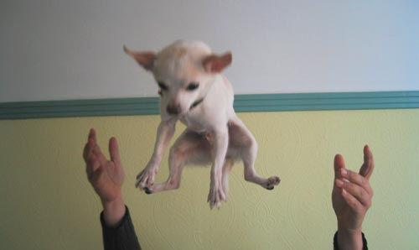

Dataset & Methods
Stanford Dogs Dataset
20,580 Images
120 Labeled Breeds
150+ Images/Breed

Slide 5
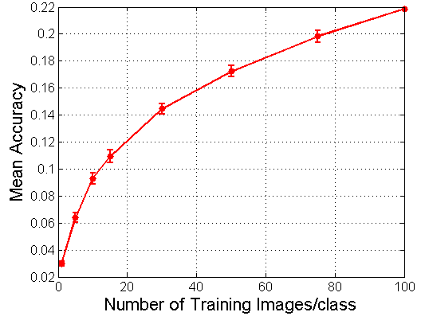
Stanford Start
Prior work on Dataset offered some starting help on base metrics
Data had a test/train split inbuilt
*Aditya Khosla, Nityananda Jayadevaprakash, Bangpeng Yao and Li Fei-Fei. Novel dataset for Fine-Grained Image Categorization. First Workshop on Fine-Grained Visual Categorization (FGVC), IEEE Conference on Computer Vision and Pattern Recognition (CVPR), 2011. [pdf] [poster] [BibTex]

Slide 6
Model Selection
VGG16 ImageNet weights transferred in as the convolutional base
Images originated from the ImageNet Dataset
Ease of implementation with transfer learning
Optimizers
RMSprop
Adam
Image Augmentation

Slide 7

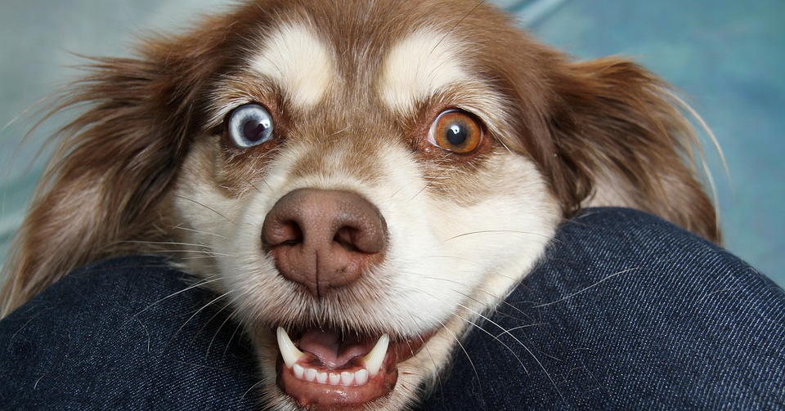

Results and Reflections

Slide 8
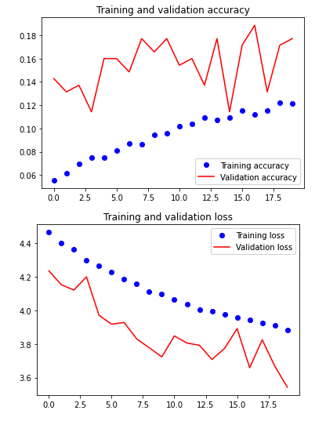
The Good, The Bad & The Better
Later Models show significant promise:
Initial Models were incredibly inaccurate
Accuracy never exceeded 5%
Convergence after 4 Epochs
Lack of data required many hyperparameter tunings

Slide 9
Final Results
Despite significant augmentation and tuning, the VGG16 base is only able to meet the Stanford at just over 20%

Slide 10
Next Steps
The limitations of computational availability as well a additional data may have rendered VGG16’s convolutional base less effective. Next steps would be Resnet50 with less input image reduction.
Look at the effect of including known mixed-breeds (e.g.Puggle:Beagle/Pug)
Build interface to receive an input image and output the soft probability predictions for that image

